Slide 1

Giving a Presentation
How to give a good presentation
School of Computing and Information
Department of Computer Science

Slide 2
How to give a good presentation
Decide on content of value to audience
Organize your thoughts on slides
Practice your delivery

Slide 3
How to give a good presentation
Decide on content of value to audience
Organize your thoughts on slides
Practice your delivery

Slide 4


Decide content based on audience and time
Your audience: Generally smart individuals
Computer Scientists? Yes
Knowledgeable about your area? Maybe
Knowledgeable about your problem? Probably not
Time is usually limited
Invited talk: < 1 hour
Conference talk: 20 minutes or so
Elevator talk: < 2 minutes
Your talk: 5 minutes
This is not a lot of time…
Bottom line: Your audience should learn something from your talk

Slide 5
How to give a good presentation
Decide on content of value to audience
Organize your thoughts on slides
Practice your delivery

Slide 6



How should I organize my thoughts?
This is a hard problem…
… with interesting applications…
… that builds on prior work…
Two sub-parts:
You solved a problem
You used neat technological advancements to do this

Slide 7
Create an Outline
It should be more than:
Introduction
Implementation
Outcome
Write full sentences of what you want to get across
Intro: I worked on project X that fulfilled need Y
The project was challenging because it had to scale to a million users
Existing tools A, B, C are available to tackle the problem
Implementation: I used tool B to implement project X
Tool B was chosen over A and C because it is more scalable
I designed the system on the cloud to scale dynamically (diagram)
While coding, I found these difficulties with scaling and solved it by…
Outcome: Project X fulfilled need Y and more
Putting the sentences together should form a story

Slide 8
Create Slides
With a good outline, creating slides is straighforward
Title the slide based on the outline bullet point
Add slide content with focus on that title
Add figures in support of content

Slide 9
How to give a good presentation
Decide on content of value to audience
Organize your thoughts on slides
Practice your delivery

Slide 10
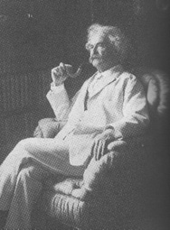
Practice, Practice, Practice
Practice makes better
Alone: Work on your “script”. Try recording yourself!
Peer group: Get used to other people being around
Broader population: Assess outsider comprehensibility
It takes three weeks to prepare a good ad-lib speech
- Mark Twain

Slide 11

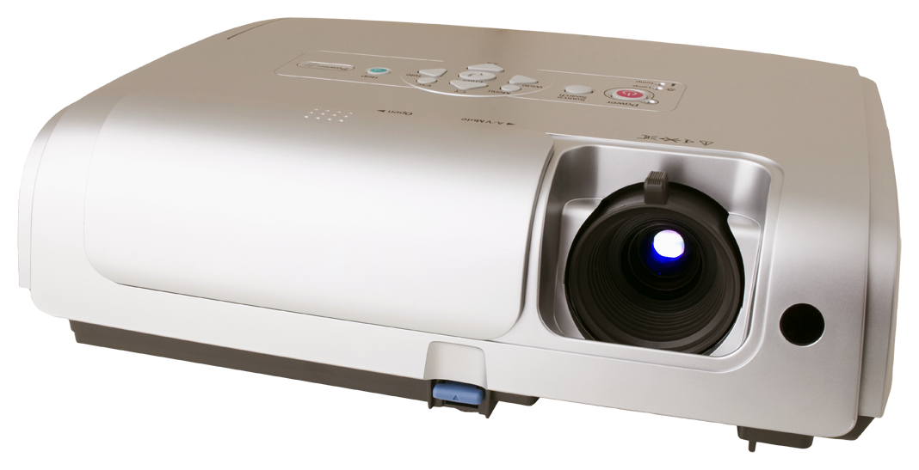
It’s not just what you say, but how you say it
Body language says a lot
Make eye contact with your audience
Some movement is good to draw attention
Have a measured pace
Present one primary idea per slide
Use slide titles to convey take-away message
Refer to every item on the slide
If you don’t, better to remove that item
Avoid reading from your slides
Slides are there for the audience, not you

Slide 12
Make your delivery engaging
Do not lose sight of the big picture
Audience should always know where you are taking them
Audience may need refocusing from time to time
Give context
Why are you telling me this? Where does it fit in?
Why did you make that choice? What were the constraints?
Was that choice successful? Why or why not?

Slide 13
Pitfalls you want to avoid

Slide 14
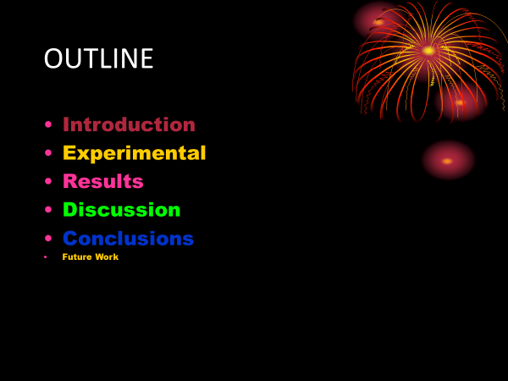
Pitfall 1: Admire my beautiful slide

Slide 15
A slide is not abstract art
Fonts, colors, and style should be consistent
If not, the difference should convey a meaning
By the way, was that outline slide really necessary?
Most talks are structured that way – no information content

Slide 16
Pitfall 2: Look at my amazing code
This is my pseudocode for solving Hanoi towers:
void solve_hanoi(n, src -> dest, temp)
{
if (n == 0) return;
solve_hanoi(n-1, src -> temp, dest);
move(1, src -> dest);
solve_hanoi(n-1, temp -> dest, src); }
↑ ↑ ↑ ↑ ↑ ↑ ↑ ↑ ↑ ↑ ↑ ↑ ↑ ↑ ↑ ↑ ↑ ↑ ↑ ↑ ↑ ↑ ↑ ↑ ↑ ↑ ↑ ↑ ↑
Warning: Example of a bad slide. Do not imitate.

Slide 17
Nobody wants to read your code
If you still feel it is important
Explain at a high level what the code is doing
Focus audience attention at the interesting part

Slide 18
Towers of Hanoi: Recursive Solution
src
temp
dest
Move all disks at src → dest
With the help of temp
Rule: disks must always be stacked smallest → largest
Move n-1 disks into temp
Recursive formulation as original problem, just with n-1 disks
Move 1 disk into dest
Move n-1 disks into dest
Again, n-1 version of same problem

Slide 19
Towers of Hanoi: Recursive Solution
Recursive solution for the Hanoi towers:
void solve_hanoi(n, src -> dest, temp)
{
if (n == 0) return;
solve_hanoi(n-1, src -> temp, dest);
move(1, src -> dest);
solve_hanoi(n-1, temp -> dest, src); }
Solve moving n-1 disks with the power of recursion!

Slide 20
Pitfall 3: I am a math whiz

Slide 21
Well guess what. Many are not.
Translate math to plain English whenever you can
At least highlight what matters, and what is the take home message
Increasing the elements of decreases the value of the function

Slide 22
Pitfall 4: Just read my text
Proof sketch:

Slide 23
Then why am I listening to you?
Having too much to read can interfere with listening
Reading and listening use same part of the brain
Both require language processing
Use figures and diagrams as much as possible
Interferes much less with listening
Write text as part of diagrams that visually add meaning
Tables, flow charts, tree structures, pyramids, …

Slide 24
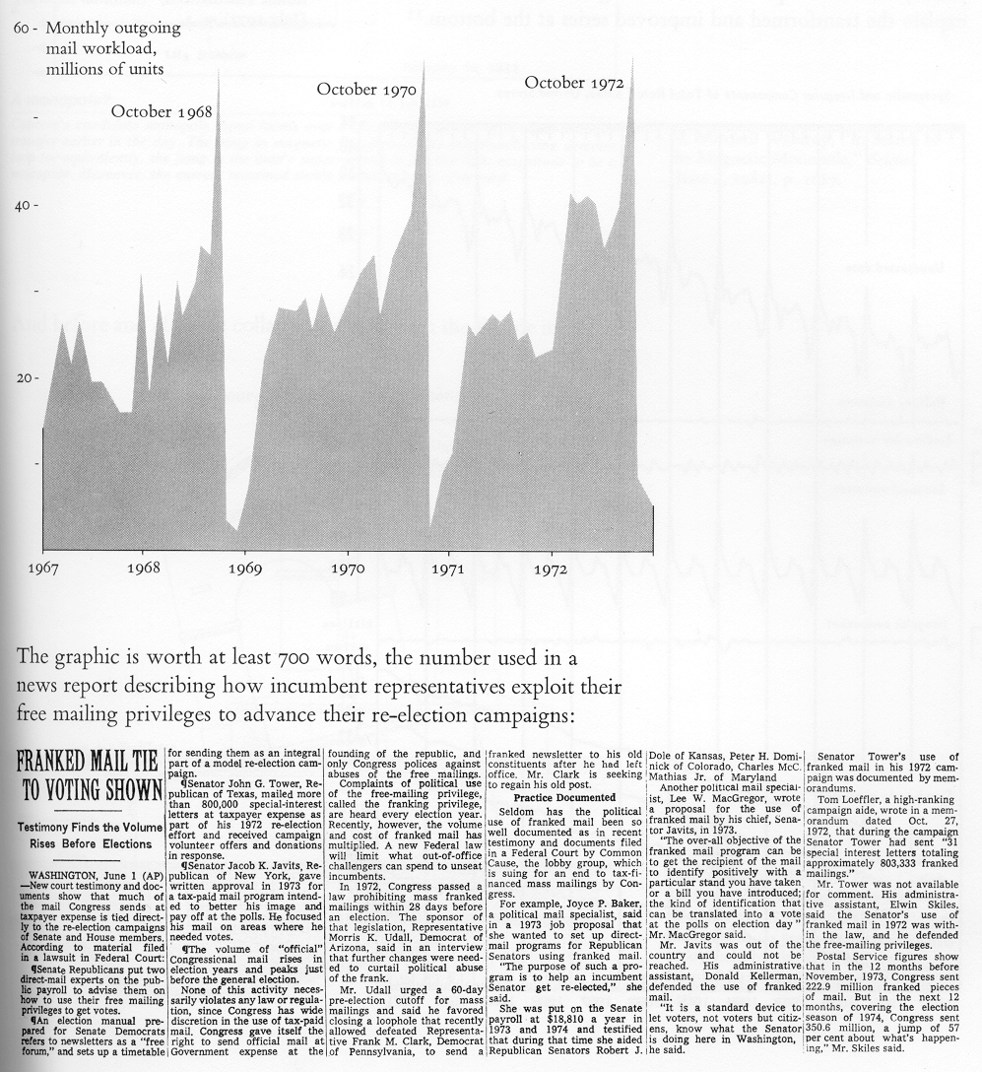
Pitfall 5: Use figure but don’t explain
Don’t leave a picture hanging there and expect your audience to interpret it
If you have something on your slide that you don’t explain, it is just noise.

Slide 25
A picture is worth a thousand words But only if you explain it!
Put in graphical cues to focus attention
Point to the figure and explain each part
Interpret the figure on behalf of the audience
Election Months
Number of letters sent by congress

Slide 26

Pitfall 6: Acronyms and jargons makes me look smart!
IMHO, ARE = ADIH. TBH, FUBAR & 2M2H.
Translated: In my humble opinion, an acronym rich environment is another day in hell. To be honest. Its f***ed up beyond all recognition and too much to handle.
Acronyms can be useful but only if you explain them!

